Slide 1
A TEAM HAS NO NAME
MEMBERS :
AVANEESH KUMAR PATHAK
ABHINAV GUPTA
ABHISHEK SINGH

Slide 2
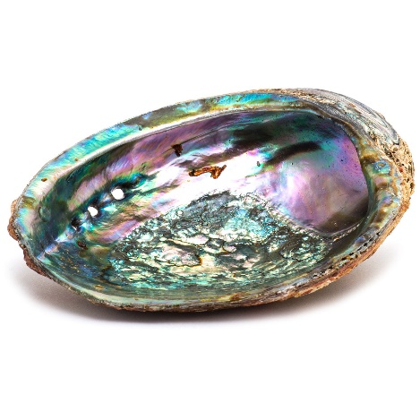
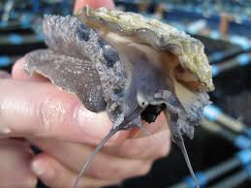
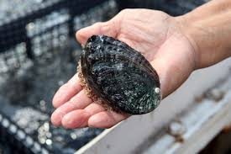
ABALONE AGE PREDICTION

Slide 3
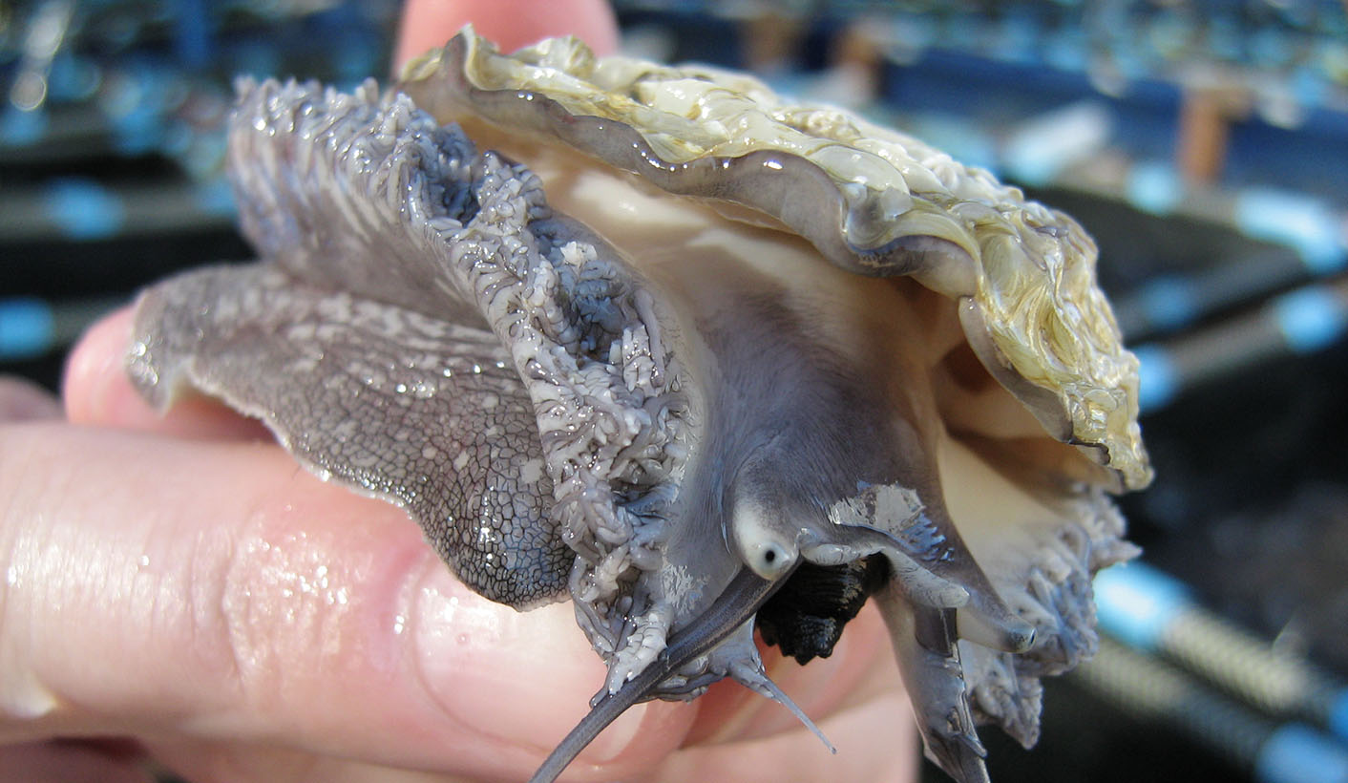
WHAT IS AN ABALONE ?

Slide 4
HOW TO PREDICT THE AGE WITHOUT CUTTING THE ABALONE’S SHELL ?

Slide 5
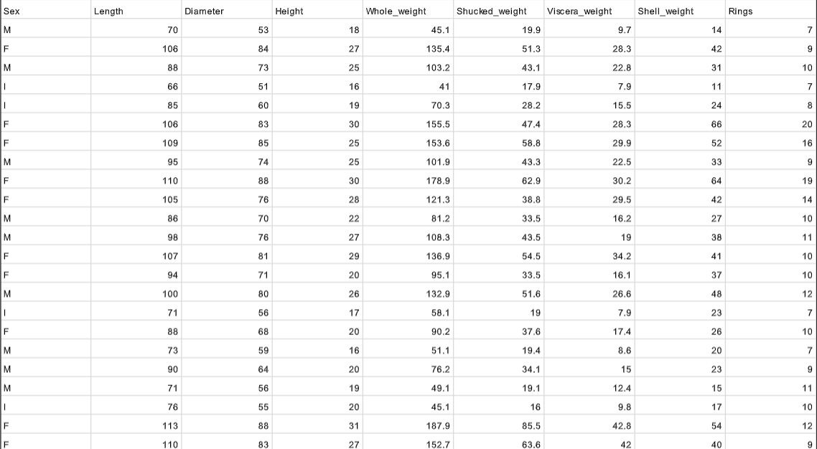
DATA SET

Slide 6
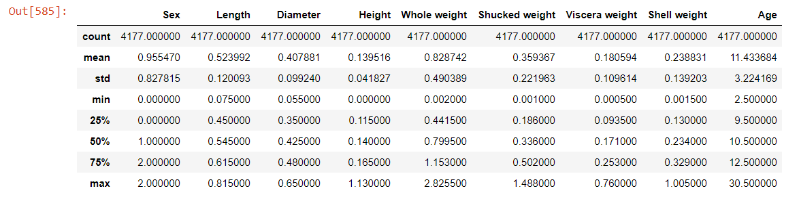
DESCRIPTION

Slide 7
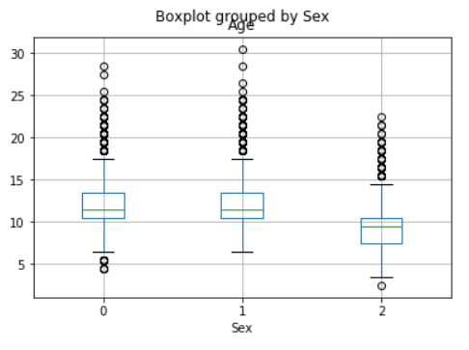
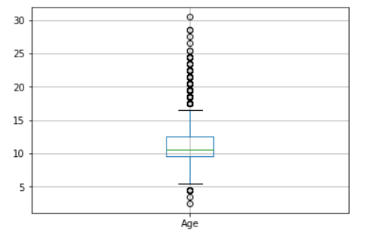
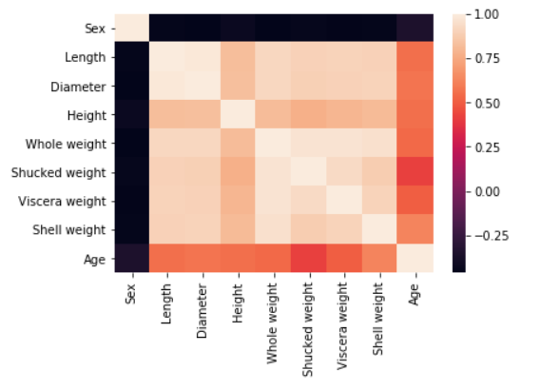
Heat Map

Slide 8
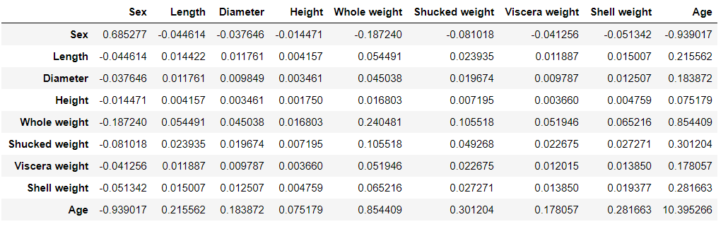
COVARIANCE

Slide 9
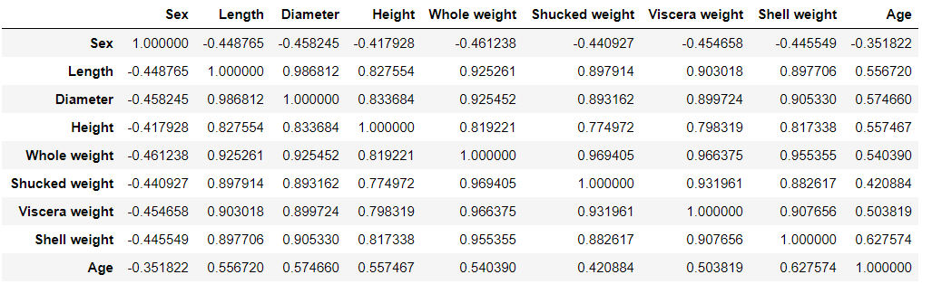
CORRELATION

Slide 10
SINGLE LINEAR
REGRESSION

Slide 11
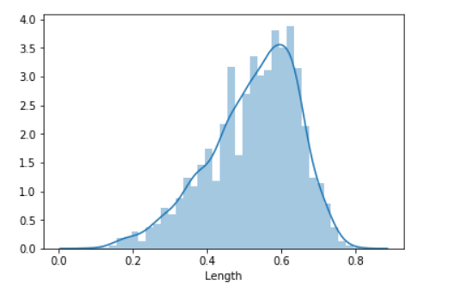
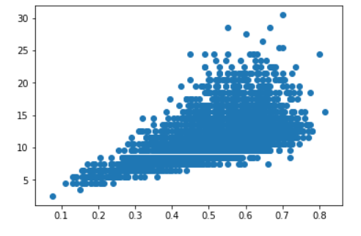
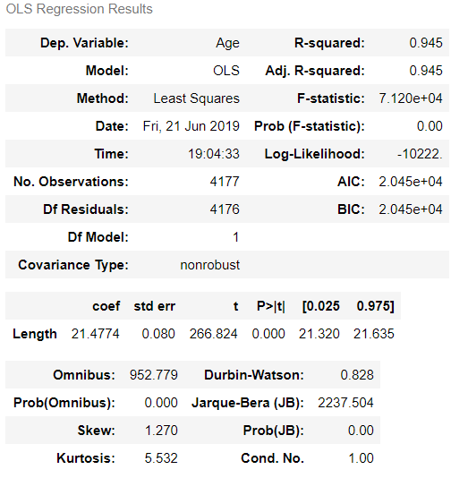
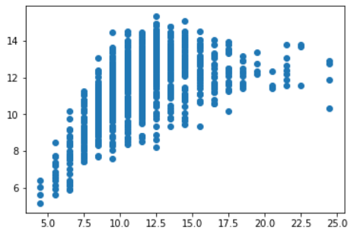
LENGTH AND AGE
Accuracy : 31.4 %

Slide 12
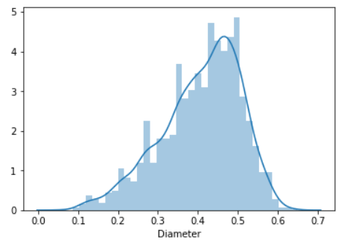
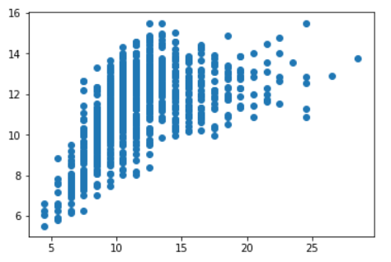
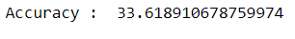
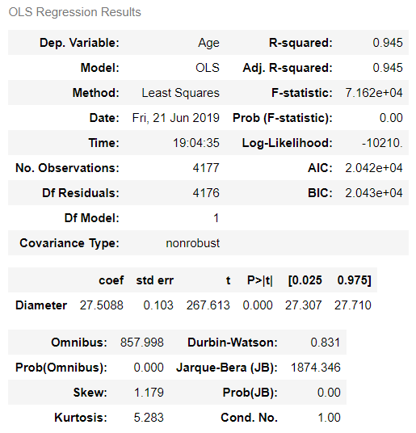
DIAMETER AND
AGE

Slide 13
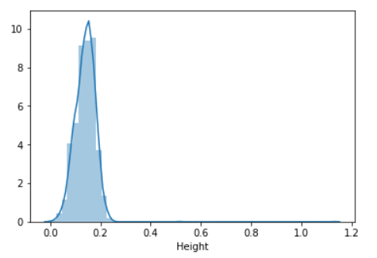
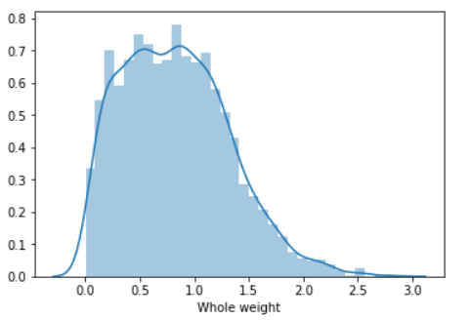
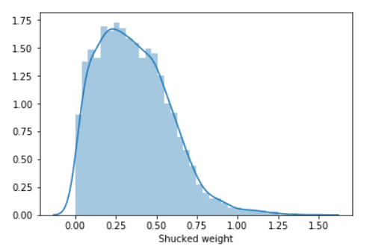
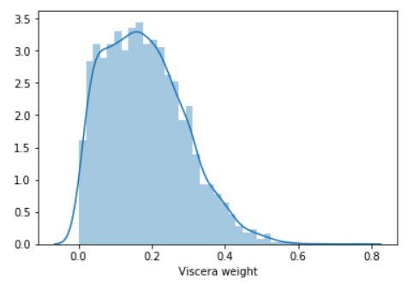
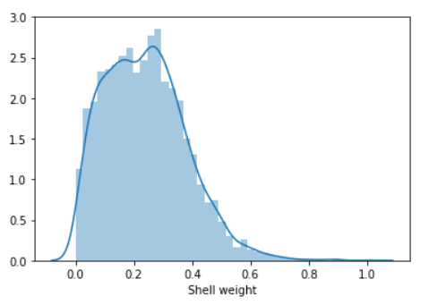
AGE AND HEIGHT , WHOLE WEIGHT , SHUCKED WEIGHT ,
VISCERA WEIGHT , SHELL WEIGHT

Slide 14
MULTIPLE LINEAR REGRESSION

Slide 15
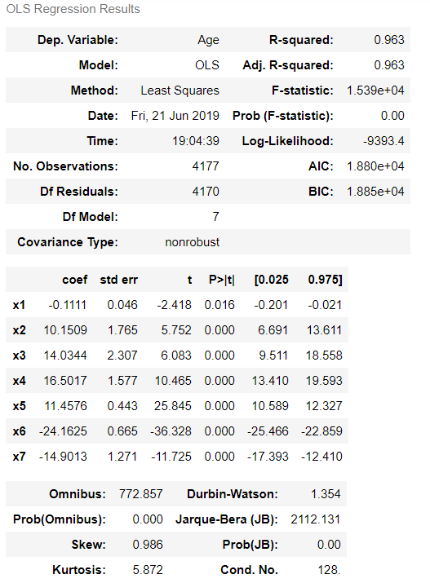

Slide 16
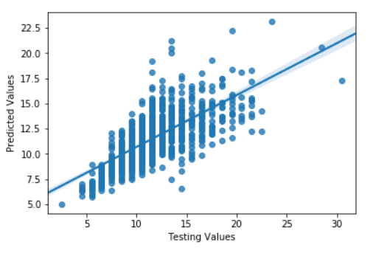
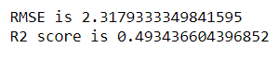
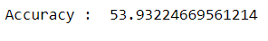

Slide 17
KNN
(K NEAREST NEIGHBOURS)

Slide 18
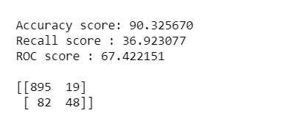
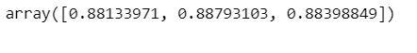

Slide 19
LOGISTIC
REGRESSION

Slide 20
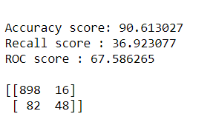
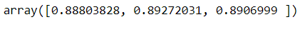

Slide 21
Naive Bayes Classification

Slide 22
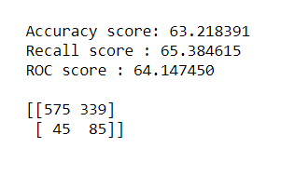

Slide 23
Support Vector Classification

Slide 24
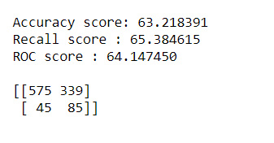

Slide 25
Decision Tree Classifier

Slide 26
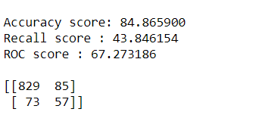
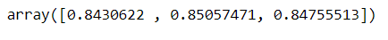

Slide 27
Random Forest Classifier

Slide 28
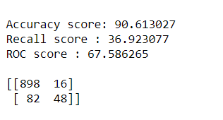
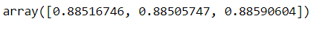

Slide 29
ROC CURVE
ROC CURVE

Slide 30
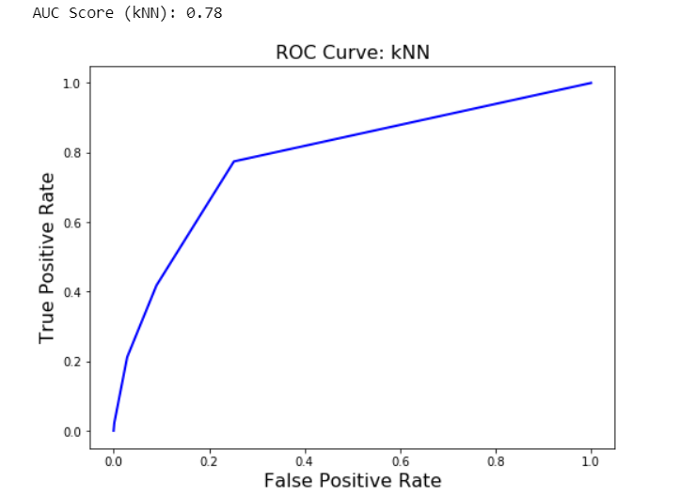
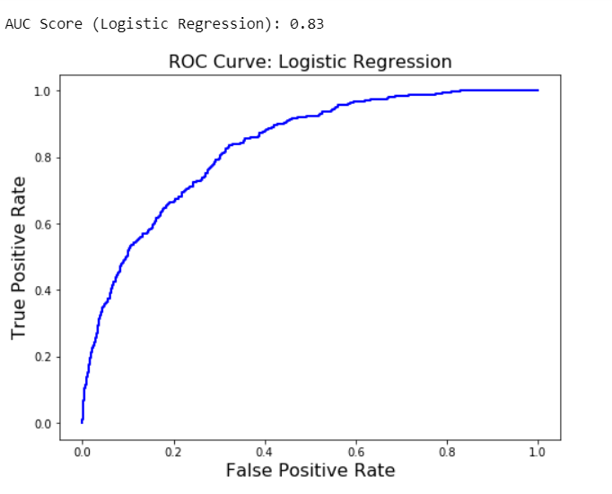

Slide 31
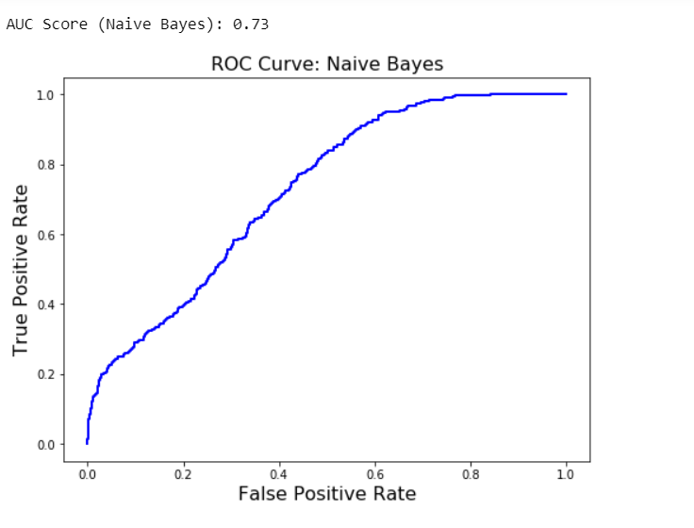
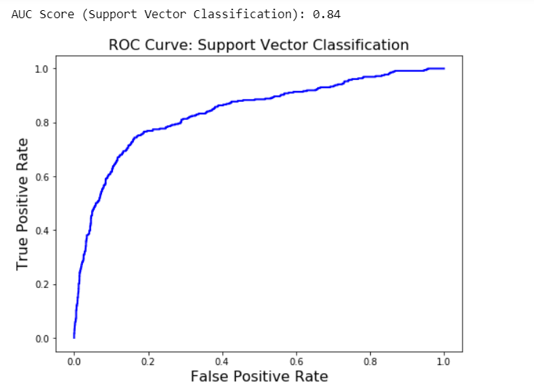

Slide 32
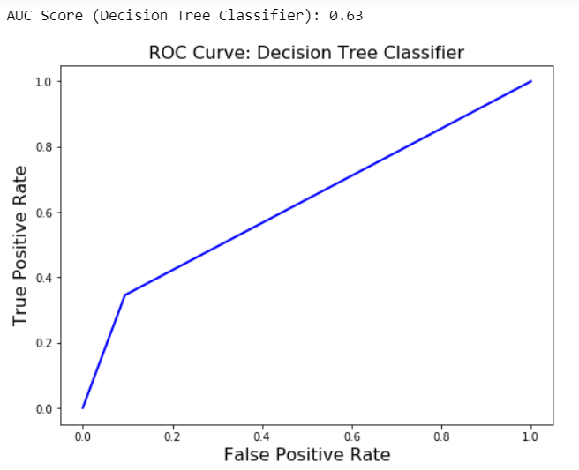
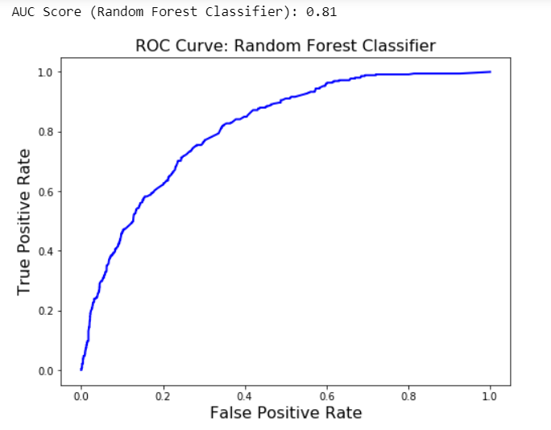

Slide 33
CONCLUSION

Slide 34
The algorithms used for this model were :
Single Linear Regression
Multiple Linear Regression
KNN Classification
Logistic Regression
Naive Bayes Classification
Support Vector Classification
Decision Tree Classifier
Random Forest classifier

Slide 35
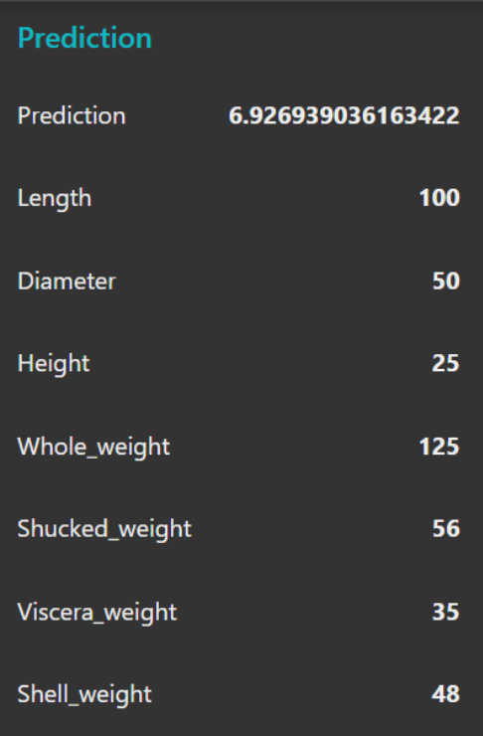
UI Prediction

